Slide 2


Slide 3

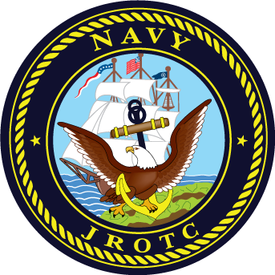
Sergeant
USMC E-5

Slide 4
What does CPR stand for?

Slide 5
Cardio Pulmonary Resuscitation

Slide 6


Sleeve Insignia
Collar Device

Slide 7
Senior Chief Petty Officer E-8

Slide 8
Who is the Secretary of the Navy (SECNAV)?

Slide 9
Secretary of the Navy (SECNAV)
The Honorable Richard V. Spencer

Slide 10
The first 10 Amendments of the Constitution are called…?

Slide 11
Bill of Rights.

Slide 12


Slide 13
First Sergeant
USMC E-8

Slide 14


Sleeve Insignia
Collar Device

Slide 15
Master Chief Petty Officer E-9

Slide 16
How many steps are in “Quicktime?”

Slide 17
It is a 30 inch step, 120 steps per minute.

Slide 18


Slide 19
Gunnery Sergeant
USMC E-7

Slide 20


Sleeve Insignia
Collar Device

Slide 21
Master Chief Petty Officer
of The Navy

Slide 22
What is reveille?

Slide 23
The official start of the day.

Slide 24


Slide 25
Corporal
USMC E-4

Slide 26
Name the 4 types of Jungles.

Slide 27
Mangrove, Primary, Secondary and High Mountain.

Slide 28

Sleeve Insignia

Slide 29
Petty Officer First Class E-6

Slide 30


Slide 31
Staff Sergeant
USMC E-6

Slide 32
The Navy’s Birthday is?

Slide 33
13 October 1775

Slide 34



Slide 35
Chief Warrant Officer 4

Slide 36
The Marine Corps’ Birthday is?

Slide 37
10 November 1775

Slide 38


Slide 39
Master Gunnery Sergeant E-9

Slide 40
How many steps are in Doubletime?

Slide 41
It is a 36 inch step 180 steps per minute.

Slide 42


Slide 43
O-5 Commander OR
Lieutenant Colonel

Slide 44
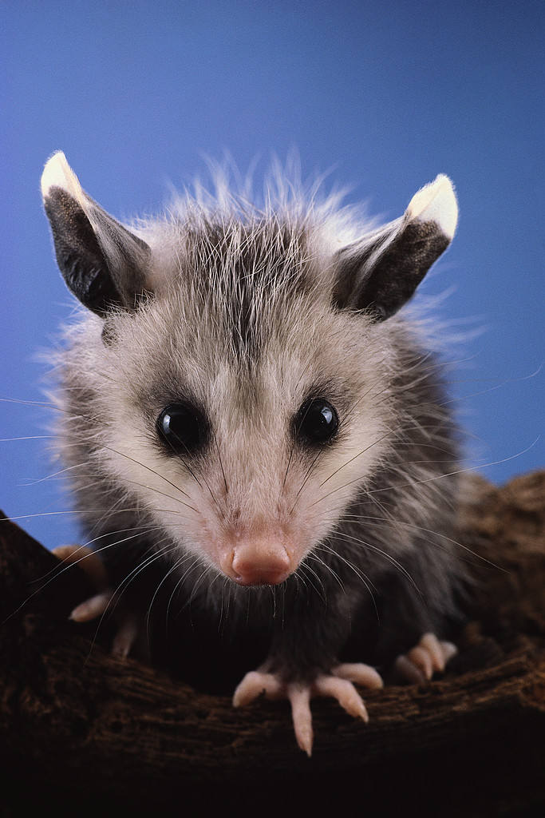
How many calories does a baked Possum have?

Slide 45
A Baked Possum has 235 calories.

Slide 46


Slide 47
Sergeant Major E-9

Slide 48
How many calories do 4-5 clams have?

Slide 49
4-5 Clams have 88 calories.

Slide 50



Slide 51
Chief Warrant Officer 3

Slide 52
How many inches are in a ½ step?

Slide 53
There are 15 inches in a half step.

Slide 54



Slide 55
Chief Warrant Officer 5

Slide 56
How many inches in full step/pace?

Slide 57
There are 30 inches in a full step/pace.

Slide 58


Slide 59
Lance Corporal E-3

Slide 60
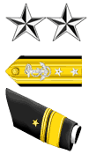

Slide 61
O-8
Rear Admiral Upper Half OR Major General

Slide 62


Slide 63
O-1
Ensign OR Second Lieutenant

Slide 64
What is the measurement for the J-bar on the male/female NSU uniform?

Slide 65
1 7/8 inches centered on the left side of the collar

Slide 66


Slide 67
Sergeant Major
Of The Marine Corps

Slide 68


Slide 69
O-3
Lieutenant OR Captain

Slide 70


Slide 71
Admiral or General O-10

Slide 72


Slide 73
Lieutenant Junior Grade
O-2

Slide 74
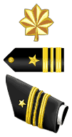

Slide 75
Lieutenant Commander
O-4

Slide 76



Slide 77
Chief Warrant Officer 2

Slide 78
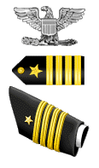

Slide 79
Captain O-6

Slide 80


Slide 81
Rear Admiral Lower Half
O-7

Slide 82


Slide 83
Rear Admiral LH or Brigadier General O-7

Slide 84
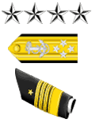

Slide 85
Admiral
O-10

Slide 86


Slide 87
Vice Admiral or
Lieutenant General O-9

Slide 88


Slide 89
Commander or
Lieutenant Colonel O-5

Slide 90


Slide 91
Fleet Admiral
O-10

Slide 92


Slide 93
Lieutenant Junior Grade or
First Lieutenant O-2

Slide 94
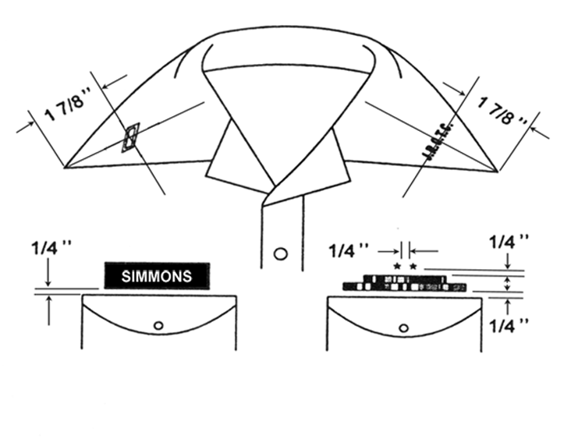
SA/Seaman

Slide 95


Slide 96
Lieutenant or
Captain O-3

Slide 97


Slide 98
Captain or Colonel O-6

Slide 99
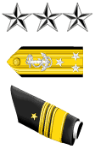

Slide 100
Vice Admiral O-9

Slide 101


Slide 102
Rear Admiral Upper Half or Major General O-8

Slide 103
Who is the Secretary of Defense (SECDEF)?

Slide 104
Secretary Of Defense (SECDEF)
    The Honorable James Mattis
Secretary Of Defense (SECDEF) The Honorable Robert M. Gates

Slide 105
Seaman/E-3

Slide 106
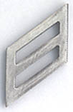

Slide 107

Men's Hair
Shall be neat, clean, and well-groomed;
above the ears and around the neck;
tapered upwards 3/4-inch and outwards
no more than 3/4-inch; no longer than
4 inches; bulk not exceeding 2 inches

Slide 108
Ensign or
Second Lieutenant O-1

Slide 109


Slide 110
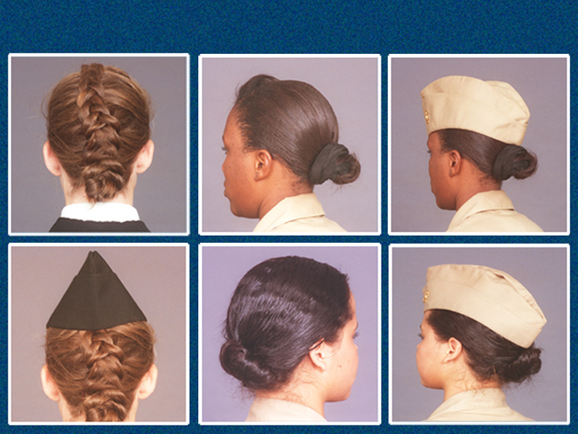
Women's Hairstyles

Slide 111


Slide 112
Lieutenant Commander or Major O-4

Slide 113
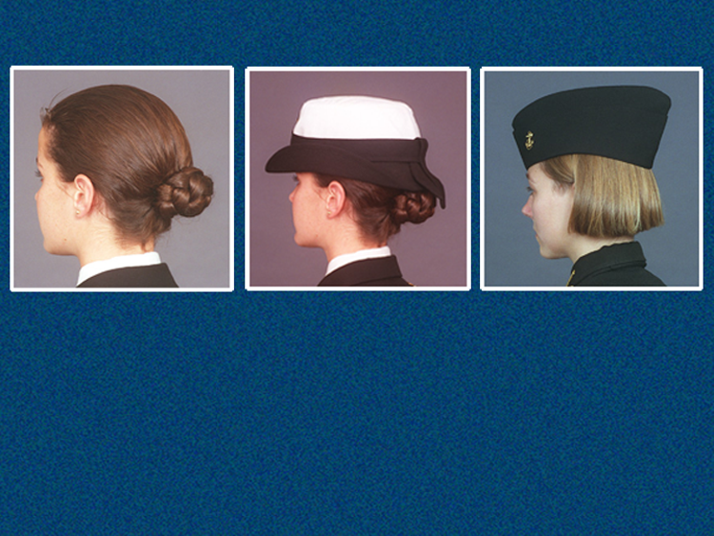
Women's Hairstyles
Various hairstyles are permitted provided
they are groomed to fit within the guide-
lines as listed in the Cadet Field Manual.

Slide 114
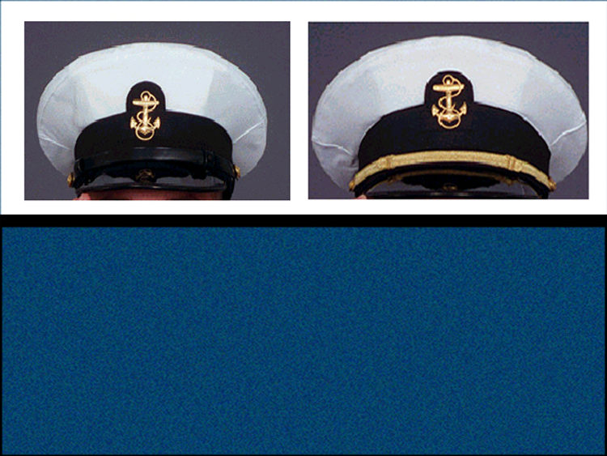
The combination cap with white cover
is worn only by chiefs and officers, and
by members of the color guard.
It can be worn with the Service Dress
Blue, Winter Blue, Winter Working Blue,
and Summer Blue uniforms.

Slide 115
Where is fouled anchor placed on the Garrison cap?

Slide 116
On the lefthand side 2 inches over from the forecrease and 1 ½ inches up from the bottom edge of the cap.

Slide 117
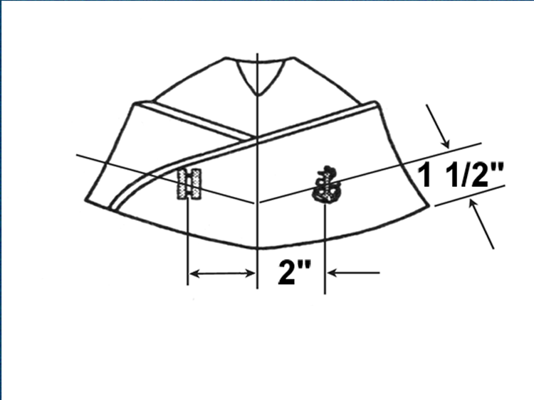
Officer

Slide 118
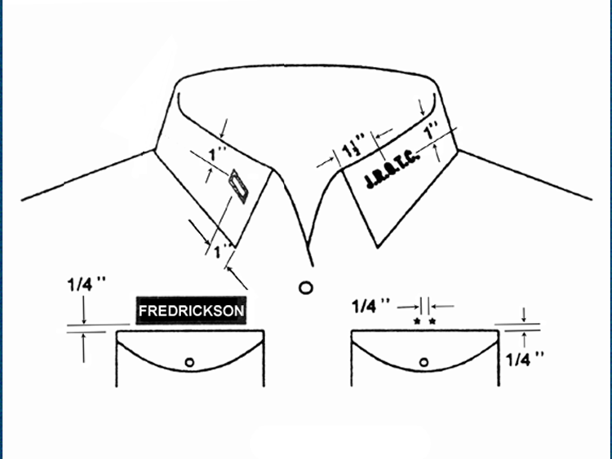
SA/Seaman

Slide 119
What are the measurements and what side is the nametag placed on the MALE NSU uniform?

Slide 120
The nametag is worn parallel to the top of the shirt right pocket and centered.

Slide 121
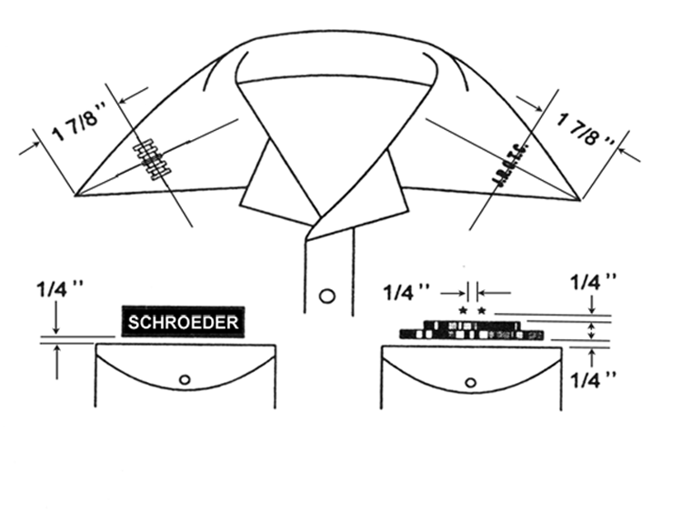
Officer

Slide 122
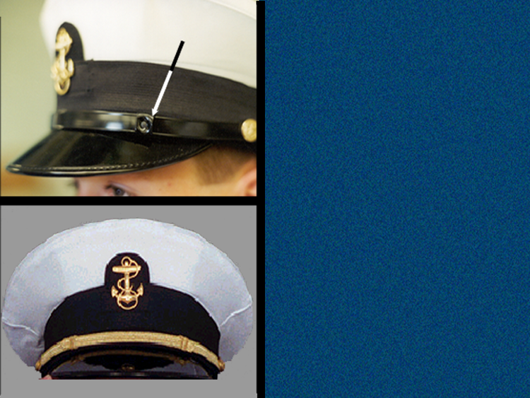
Combination
Cap
grommet
The grommet on
the enlisted cap
goes on the left
side.
There is no
grommet on the
officer's cap.

Slide 123
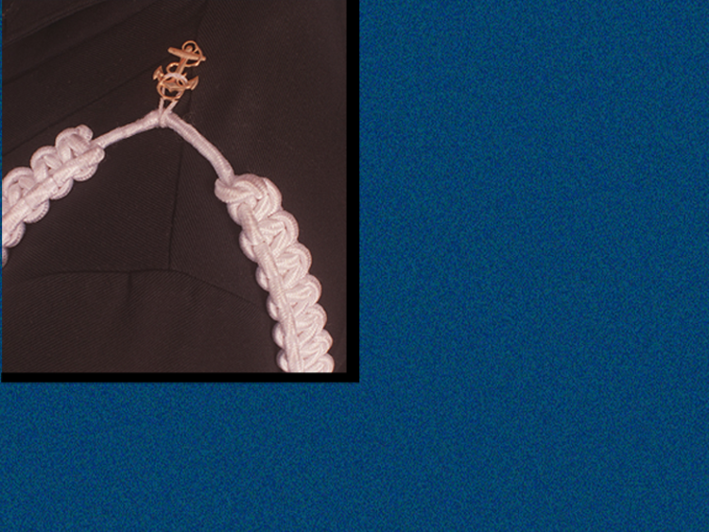
Aiguillettes will be
attached by either
a gold coat button
on the Service
Dress Blue uniform
or by a miniature
anchor on the
Winter or Summer
blue uniforms.
• Only one aiguillette per shoulder

Slide 124
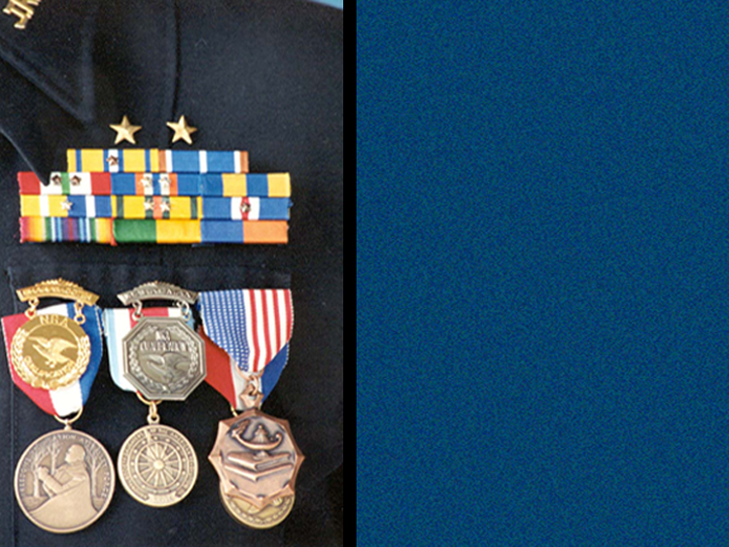
Awards and
Decorations
NJROTC ribbons
are worn only on
the following
uniforms:
• Service Dress Blue
• Winter Blue
• Summer Blue

Slide 125
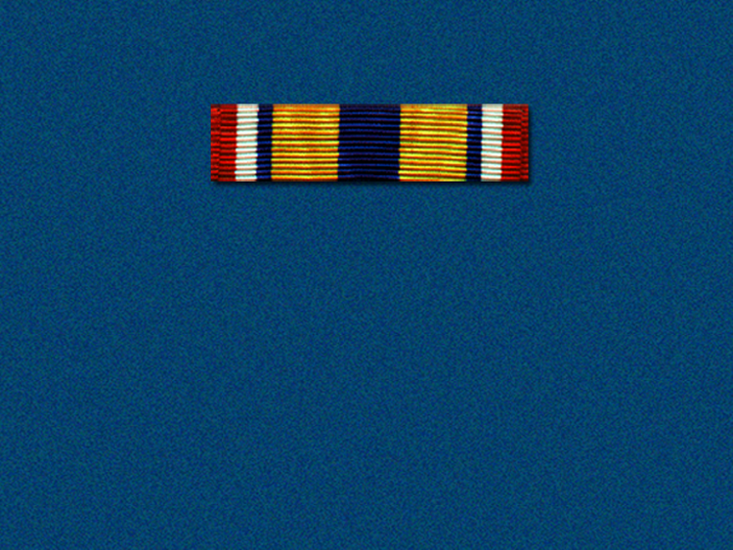
Meritorious Achievement
Awarded, WHEN EARNED, to any
NJROTC cadet who distinguishes him/
herself only by outstanding meritorious
achievement or performance of a
meritorious act. Awarded on a case-
by-case basis by the area manager.
1st precedence

Slide 126

Distinguished Unit
Awarded YEARLY to cadets in good
standing who were unit members during
the academic year in which the school
earned the Distinguished Unit status.
Awarded to only those units that
demonstrated the very highest levels of
performance.
2nd precedence

Slide 127

Distinguished Cadet
Awarded YEARLY to one cadet in each
year group with the highest combined
average for overall scholastic standing
and aptitude in NJROTC unit activities
(includes academics, homework,
physical fitness, community service,
drill, etc.).
3rd precedence

Slide 128

Honor Cadet
Awarded YEARLY to one cadet in each
year group with the highest overall
academic achievement (GPA) in school,
including the naval science courses.
4th precedence

Slide 129
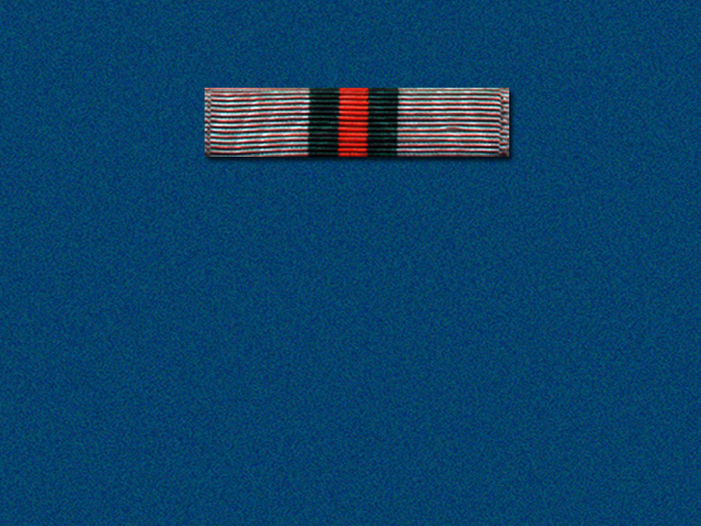
Cadet Achievement
5th precedence
Awarded, WHEN EARNED, to any cadet
who distinguish him/herself by
outstanding achievement or sustained
superior performance. The cadet must
exhibit exceptional military aptitude
and dedication to the program as well
as overall excellence in all facets of
NJROTC. Awarded on a case-by-case
basis by the area manager.

Slide 130
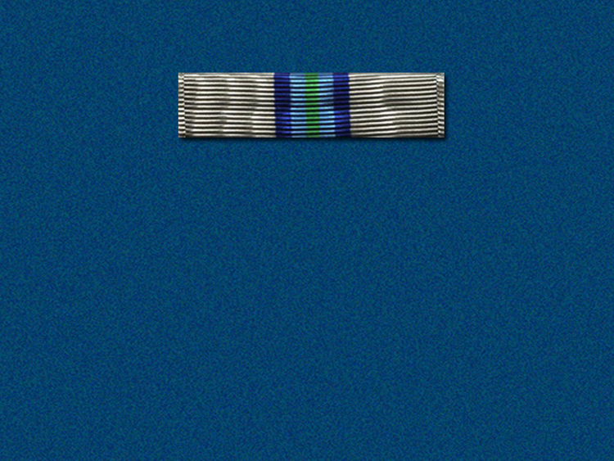
Unit Achievement
6th precedence
Awarded YEARLY to cadets in good
standing who were unit members
during the academic year in which the
school earned the Unit Achievement
status as determined by the area
manager. Awarded only to those units
that demonstrated exceptional
performance, but did not qualify for
Distinguished Unit status.

Slide 131

Military Aptitude
Awarded YEARLY to those outstanding
cadets who demonstrate an exceptional
military aptitude and dedication to the
NJROTC program.
7th precedence

Slide 132
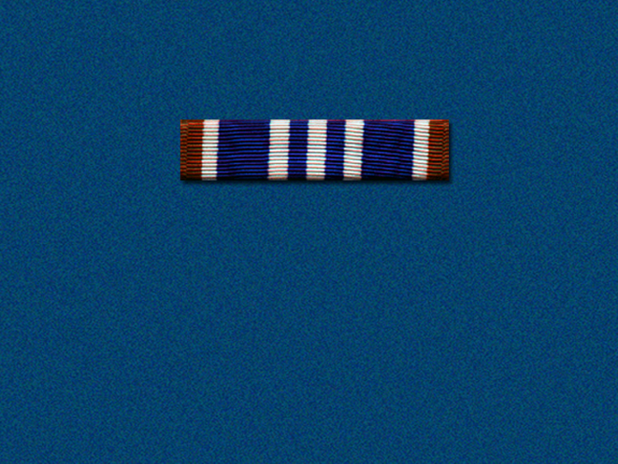
Naval Science 4
Outstanding Cadet
Awarded YEARLY to outstanding cadets
in Naval Science 4 based on citizenship,
academic performance, personal
appearance and conduct.
8th precedence

Slide 133
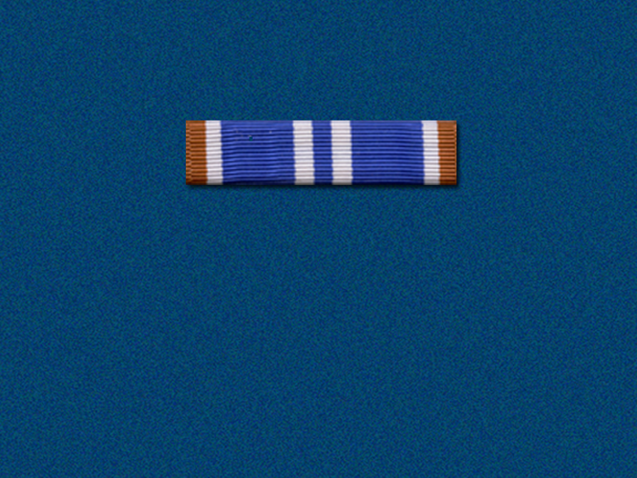
Naval Science 3
Outstanding Cadet
Awarded YEARLY to outstanding cadets
in Naval Science 3 based on citizenship,
academic performance, personal
appearance and conduct.
9th precedence

Slide 134

Academic Award
Awarded, WHEN EARNED, to each
cadet who has met any of the
following award criteria:
13th precedence

Slide 135
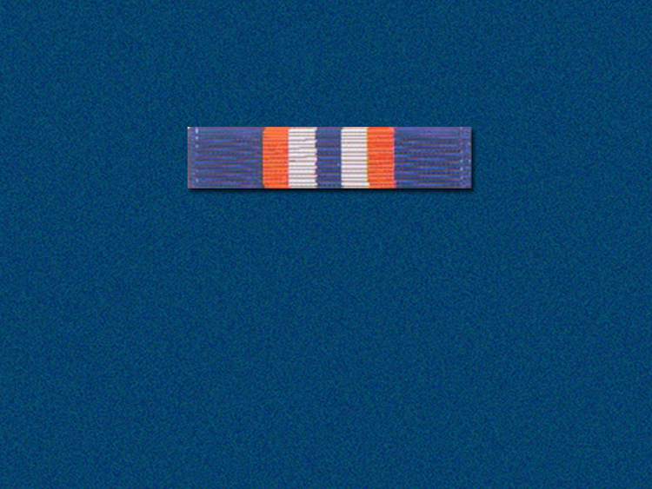
Exemplary Personal
Appearance
Awarded, WHEN EARNED, to each
cadet who displays exemplary personal
appearance and has worn his/her
uniform on all occasions required.
14th precedence

Slide 136
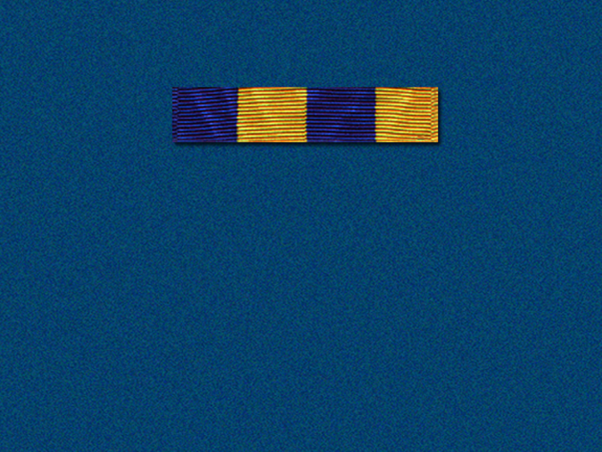
Physical Fitness
Awarded, TWICE A YEAR, to any cadet
who meets or exceeds the basic
physical fitness exercise requirements
as outlined in the Cadet Field Manual.
15th precedence

Slide 137
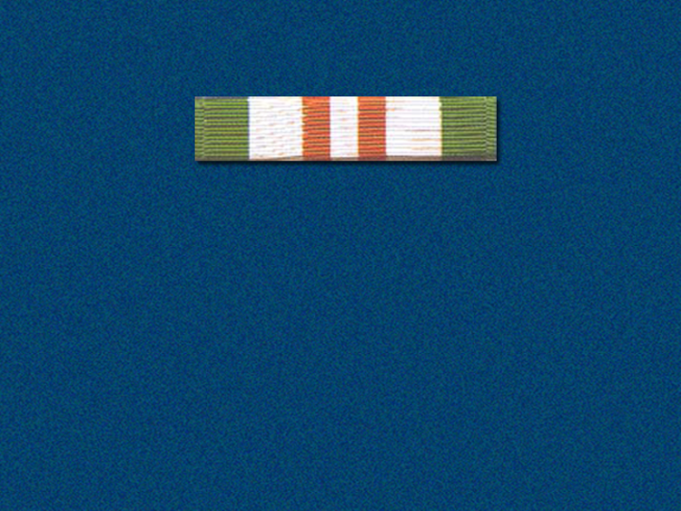
Participation
Awarded, WHEN EARNED, to any
cadet who has participated in three
events other than routine unit
activities.
16th precedence

Slide 138
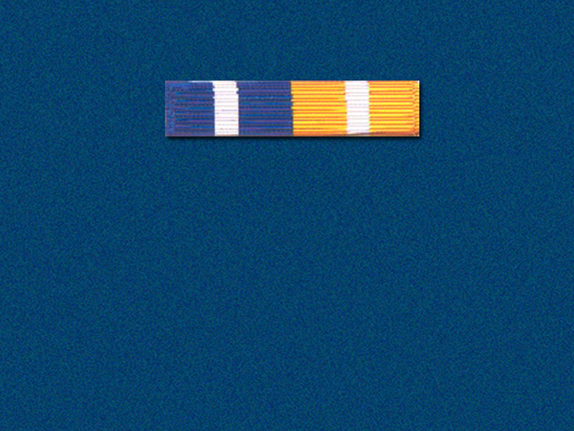
Unit Service
Awarded, WHEN EARNED, to any
cadet who has demonstrated
exemplary service and dedication
to the unit as determined by the SNSI.
17th precedence

Slide 139
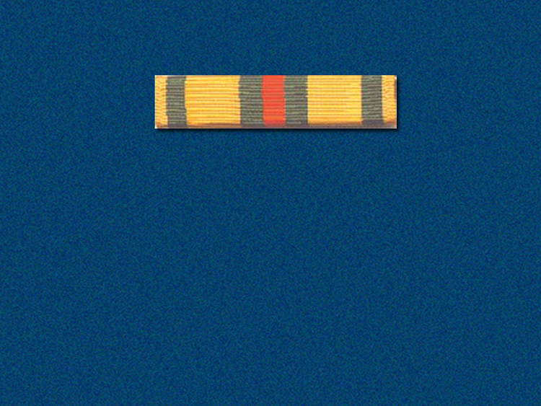
Community Service
Awarded, WHEN EARNED, to any
cadet in good standing who
distinguishes him/herself by
dedicated and outstanding
service to the community.
18th precedence

Slide 140

Drill Team
Awarded, WHEN EARNED, to each
member of a drill team in good standing
who has entered competition, or
performed at three or more official
functions.
19th precedence

Slide 141
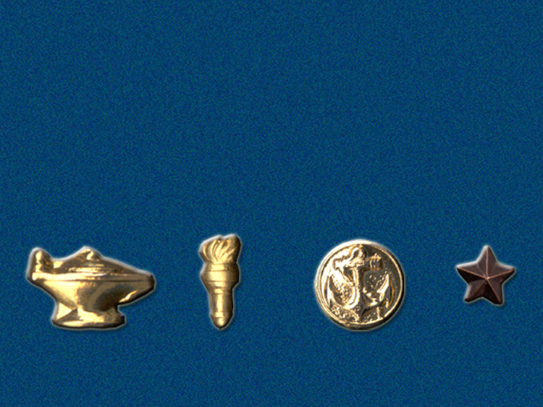
Ribbon Devices
• Worn on/with ribbons
• Represent subsequent awards

Slide 142
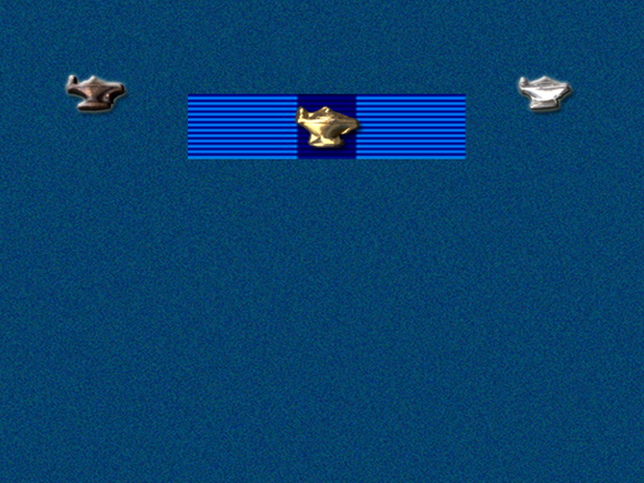
Lamp
The lamp is worn on the Honor Cadet
ribbon by each cadet achieving an "A"
in naval science as follows:
• Bronze Lamp – NS-1
• Silver Lamp – NS-2
• Gold Lamp – NS-3 & NS-4

Slide 143
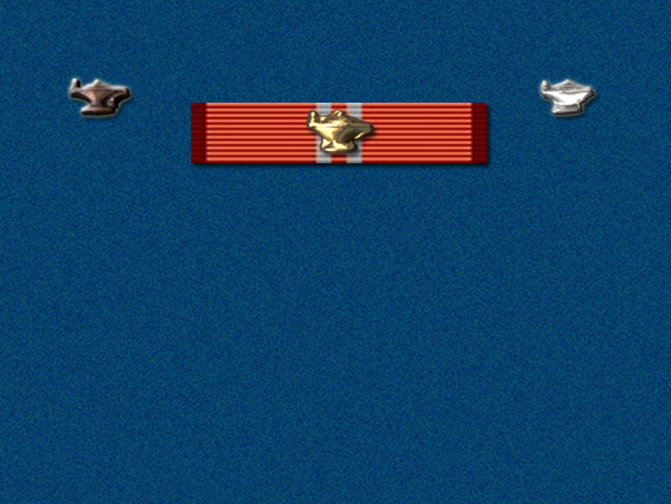
Lamp
Cadets achieving school honor roll
status for one or more semesters wear
a bronze, silver, or gold lamp on the
Academic ribbon.

Slide 144
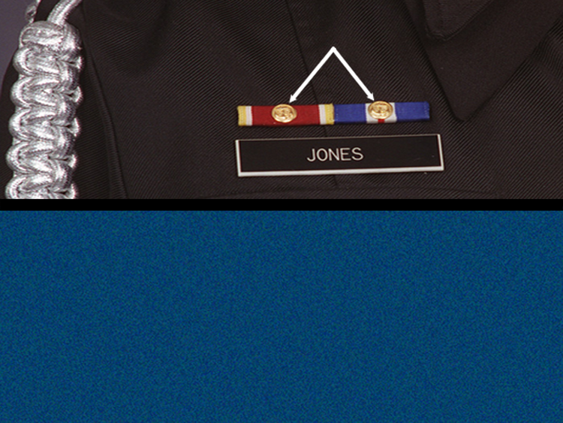
anchor
Anchor
The associated ribbon with gold anchor
is worn on the right side of the team
commander's chest. No other devices
will accompany the gold anchor when
the award is worn on the right side.

Slide 145
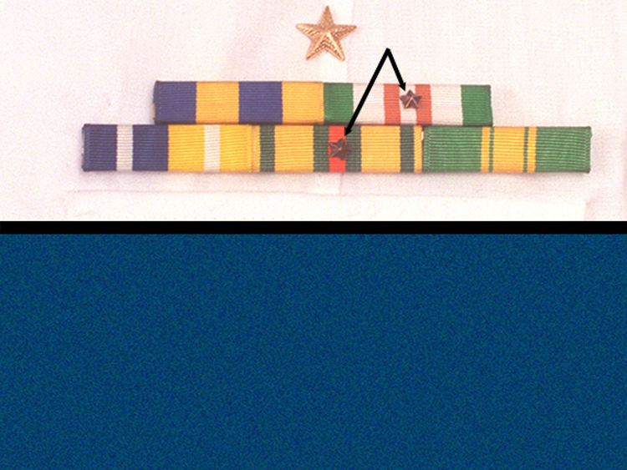
subsequent awards
Subsequent Awards
Only one of any ribbon design may be
worn. Stars issued for subsequent
awards are issued only ONCE EACH
SEMESTER. Stars are worn one ray up,
two rays down.

Slide 146

Subsequent Awards
Second Award
Third Award
Fourth Award
Fifth Award
Sixth Award
Seventh Award
Eighth Award
=
=
=
=
=
=
=

Slide 147

Q.6. What personnel wear the
white combination cap with the
Service Dress Blue uniform?

Slide 148
Q.6. What personnel wear the
white combination cap with the
Service Dress Blue uniform?
A.6. Officers, chiefs, and color
guard

Slide 149
Q.7. What optional item is
authorized for wear by female
cadets enrolled in naval science
two and above?

Slide 150
Q.7. What optional item is
authorized for wear by female
cadets enrolled in naval science
two and above?
A.7. Plain black dress pumps

Slide 151
Q.10. What does the service
designation star insignia
represent?

Slide 153
Q.10. What does the service
designation star insignia
represent?
A.10. The insignia is used to
designate number of courses/
years satisfactorily completed
in the NJROTC program.

Slide 154
Q.12. What award is awarded by the
naval science instructor for
such things as color guard, drill
team, and academic team?

Slide 155
Q.12. What award is awarded by the
naval science instructor for
such things as color guard, drill
team, and academic team?
A.12. Aiguillettes

Slide 156
Q.13. On what uniforms do cadets
wear the NJROTC ribbon
awards?

Slide 157
Q.13. On what uniforms do cadets
wear the NJROTC ribbon
awards?
A.13. Service Dress Blue, Winter
Blue, and Summer Blue

Slide 158
Q.14. What award is given to cadets
whose schools demonstrated
the very highest levels of
performance?

Slide 159
Q.14. What award is given to cadets
whose schools demonstrated
the very highest levels of
performance?
A.14. Distinguished Unit award

Slide 160
Q.15. What is the highest award
given to a NJROTC cadet?

Slide 161
Q.15. What is the highest award
given to a NJROTC cadet?
A.15. Meritorious Achievement
award

